Slide 1
IT project management
Cost management

Slide 2
Project Cost management
Cost management is the process of planning and controlling a business budget. A good cost management system helps an organization estimate and allocate its budget
For a project to be considered a success, it’s necessary that:
It delivers on the requirements and scope
Its execution quality is of a high standard
It’s completed within schedule
It’s completed within budget.

Slide 3
Importance of project cost management
The importance of cost management is easy to understand. To take a simple, real-life example, if you decide to build a house, the first thing to do is set the budget. When you have a sense of how much to spend on the project, the next step is to divide the high-level budget into expenses for sub-tasks and smaller line items.

Slide 4
Importance of project cost management
The budget will determine critical decision points such as:
Which architect to hire.
Someone who will construct and deliver the project end-to-end.
Someone who can help with a few elements and be able to work for a smaller budget?
How many stories should the structure have?
What quality of materials should be used.

Slide 5
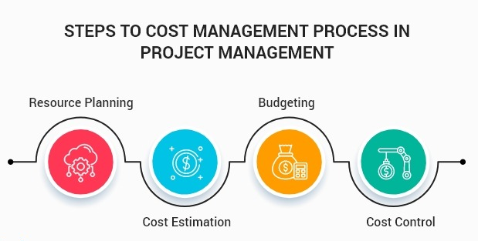
Steps of cost management
Cost management strategies are developed alongside the project plan as an integral part of project planning and management. Here are the four main steps:
Setup
Project resource planning
Budgeting and cost estimation
Cost control

Slide 6
Set up
The setup phase determines what's included in the plan. It identifies who the stakeholders are, the tools used to manage costs and the data structure needed to track them. Key performance indicators (KPIs) should be defined at this stage to measure cost management effectiveness throughout the project.

Slide 7
Resource planning
This planning phase identifies the resources needed to complete the project. These could be physical materials, information assets, staff and cloud computing resources.
Resource planning determines resource allocation, including how much of a resource is needed, for how long and how it will be allocated.
Advanced resource planning tools integrated with cost management software can streamline this process and provide real-time updates on resource availability and cost impact.

Slide 8
Budgeting and cost estimation
In this stage, project teams develop a project budget. Budgeted cost estimates become more specific as the project scope is refined. As resources are allocated, a picture of the full project costs emerges.
To gain insight, project managers compare the current project to earlier ones. They can use top-down and bottom-up estimation methods.
In the top-down approach, upper management determines the project duration, tasks, activities and estimated costs for each. In a bottom-up approach, each team estimates the duration and allocated budget for their individual tasks.

Slide 9
Cost control
This phase involves monitoring and controlling costs using data from different project teams. Managers track how costs differ from the estimated budget and take action to accommodate cost overruns, reduce budget variances and cap the budget when necessary. Effective cost management processes require accurate cost reporting. This involves access to real-time data and insight, ideally leveraging data visualization.

Slide 10
Common cost management problems
Budget is too small.
Cost estimates are inaccurate.
Team request unplanned resources.
Project is behind schedule, which will increase costs if not corrected.
Clients keep adding request and features to project specs, which drives up cost.

Slide 11
How to avoid problems
Make sure your budget is realistic at project start.
Gather as much real pricing data as possible from authoritative sources.
Talk directly with teams during the resource planning stage and enforce budget limits once the project begin.
Communicate clearly with team leads and project managers and make sure all stakeholders understands that delays will increase cost.

Slide 12
Benefits of cost management
Cost management benefits include:
Lowers the risk of overspending: Cost controls help project managers keep their budgets on track and costs in control.
Encourages planning: Cost management helps identify what is or isn't working. It provides insight into resources and processes that helps managers make faster, better decisions.

Slide 13
Benefits of cost management
Facilitates financial health: Continuous monitoring, cost control and cost reporting contribute to a company's long-term financial health.
Mitigates risk: Cost management typically involves setting a risk allowance for unforeseen costs, a useful step to prevent overspending.
Supports standards: Consistent cost control, analysis and reporting help organizations adopt standards for assessing future cost data and productivity levels.

Slide 14
Challenges of cost management
Common challenges of cost management include:
Change management: Project changes are inevitable. Teams must be able to adapt to changing circumstances and manage the budget accordingly through change management.
Effective communication: Diverse stakeholders can interpret reports in different ways. A project manager might view results differently than some of these stakeholders.

Slide 15
Challenges of cost management
Tool sprawl: Managing costs using multiple tools might be necessary and that is difficult. If data integrity issues emerge, reporting and visualization capabilities can become compromised.
Project scope and budget accuracy: Poorly defined project scopes can lead to cost overruns due to inaccurate estimates. If a project manager underestimates costs, the result is typically a lack of resources and project delays

Slide 16
Role of technology in cost management
Technology plays a pivotal role in modern cost management by streamlining processes, enhancing accuracy. Here are some enabling technologies:
Artificial Intelligence and machine learning: AI-driven tools can forecast costs based on historical data and provide recommendations to optimize resource allocation. ML algorithms help identify inefficiencies and cost-saving opportunities in real time.
Cloud-based solutions: Cloud platforms like AWS and Azure offer integrated cost management tools that provide detailed insights into usage and spending. These tools can help organizations avoid unnecessary expenses and optimize resource utilization.

Slide 17
Role of technology in cost management
Data visualization tools: Tableau, Microsoft Power BI and similar software help project managers visualize cost trends and variances, simplifying decision-making.
Integration with project management tools: Cost management software now seamlessly integrates with platforms like Jira and Asana, allowing teams to monitor costs and have cohesive visibility into task progress and deadlines.

Slide 18
Project cost management tools
While cost management software is useful, it's not imperative for executing a cost management plan. Core functions these tools address include the following:
Budgeting.
Time tracking.
Reporting.
Analytics

Slide 19
Project cost management tools
Several business intelligence programs offer cost management software to help organizations monitor costs and increase profitability. Examples include the following:
Google Looker offers strong analytics for monitoring costs and generating actionable insights.
Microsoft Power BI visualizes cost trends and integrates with project management tools.

Slide 20
Project cost management tools
Azure Cost Management is part of a cloud computing service that includes a pricing calculator, alerts and dashboards that let Azure users optimize their spending and monitor use clearly. The tool also integrates with third-party tools, such as VMware Aria Cost.
AWS Cost Management is a tool set that provides dashboards and billing reports that help users track AWS cloud use and set budget goals.

Slide 21
Any questions

